Slide 1

Rockbuster Data Dissect
Jordan Novelli
Junior Analyst (In Training)
Jordan.Novelli@analyst.com
12/17/2024

Slide 2
Most important findings in the Rockbuster Data Base
QUESTIONS:
Statistics available in the film table
Top 10 countries Rockbuster’s customers are based.
Identifying the top 10 cities within the top 10 countries.
Identifying the top 5 customers from the top 10 cities who’ve spent the most at Rockbuster.
This information is paramount to understanding our customer base. With this data we can determine how our price sets drive our customers to rent our movies.

Slide 3
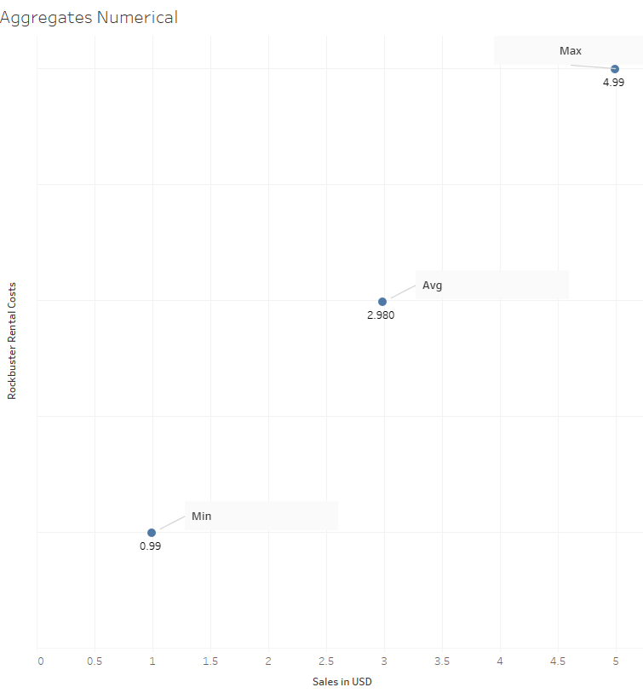
Film Stats
From the statistical data extracted from the film table we can see where our Min, Max, and Avg price points fall.
By keeping prices within an affordable range, we retain valued customers.

Slide 4
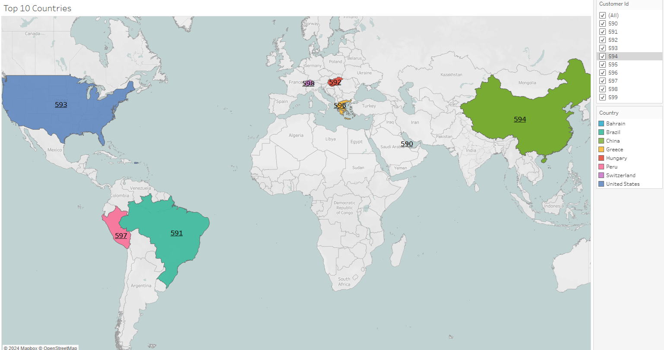
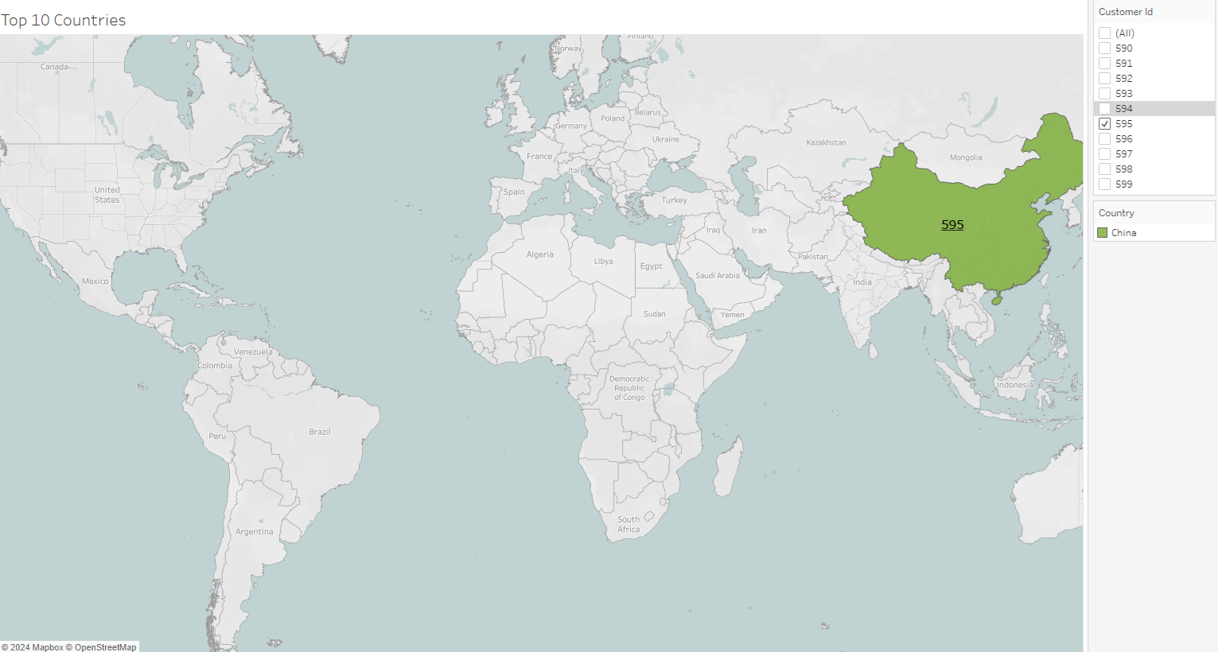

Top 10 countries
The top 10 Countries our customer reside in gives us insight into where our customer base lies.

Slide 5
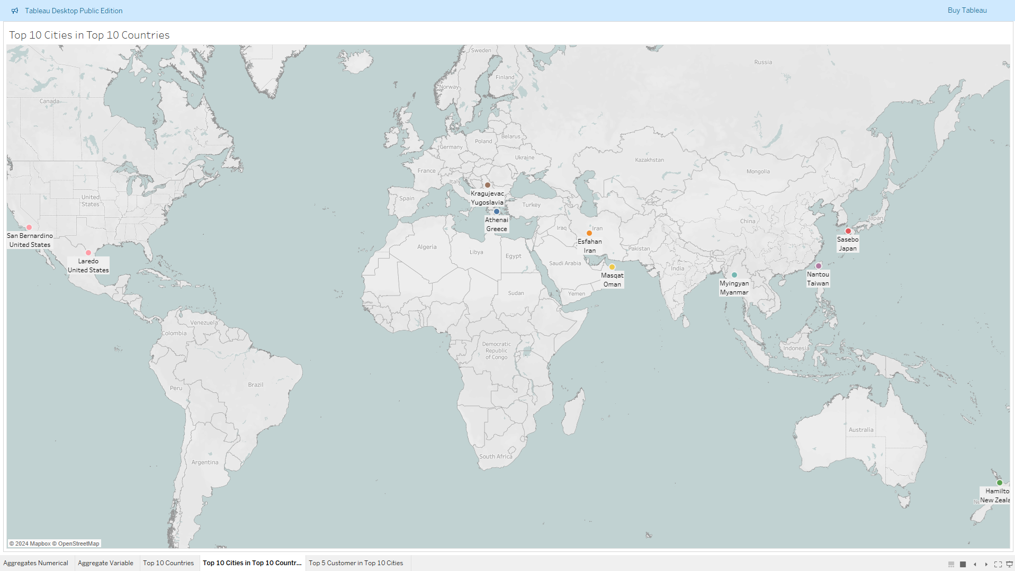
Top 10 cities within the top 10 Countries
Locating the top 10 cities within the top 10 countries gives us a more detailed understanding of our customer base.

Slide 6
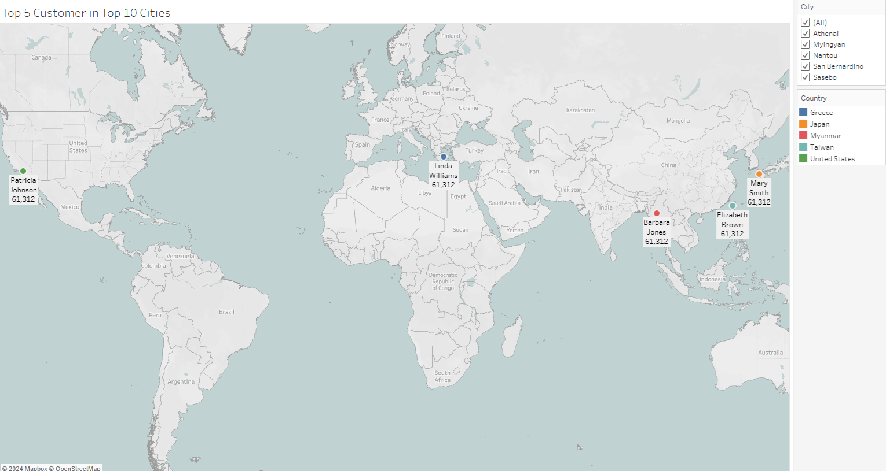
Top 5 customers from the top 10 Cities
Our most valued customers live within these cities. They’ve contributed to Rockbusters revenue more than any other customers.

Slide 7
Conclusion
We can determine with this data that many of our customers are not based in the United States alone but all around the world!
TABLEAU LINK
https://public.tableau.com/views/3_10Visualsfor3_63_7/AggregatesNumerical?:language=en-US&:sid=&:redirect=auth&:display_count=n&:origin=viz_share_link

Slide 8
Questions?

